Slide 1
Chapter-8 Parallel patterns: prefix sum An introduction to work efficiency in parallel algorithms

Slide 2
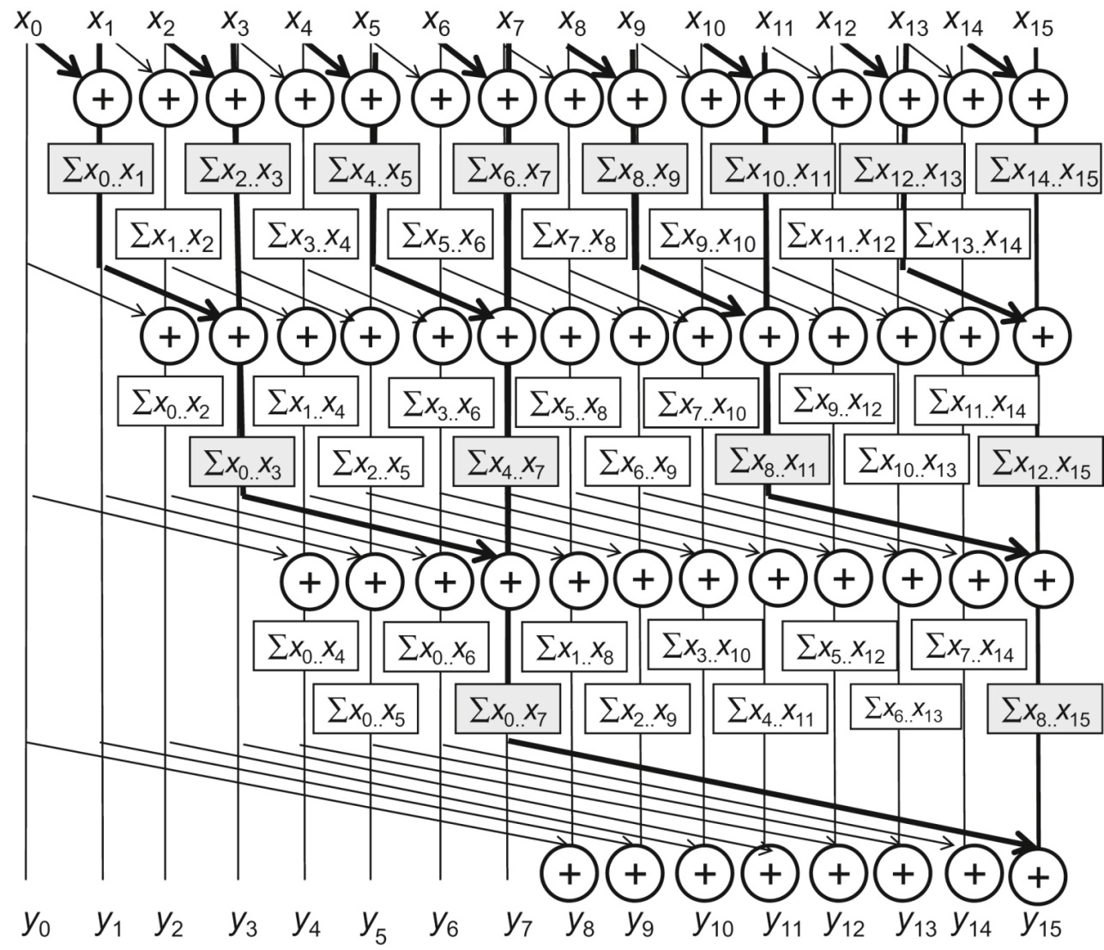
FIGURE 8.1: A parallel inclusive scan algorithm based on Kogge–Stone adder design.

Slide 3
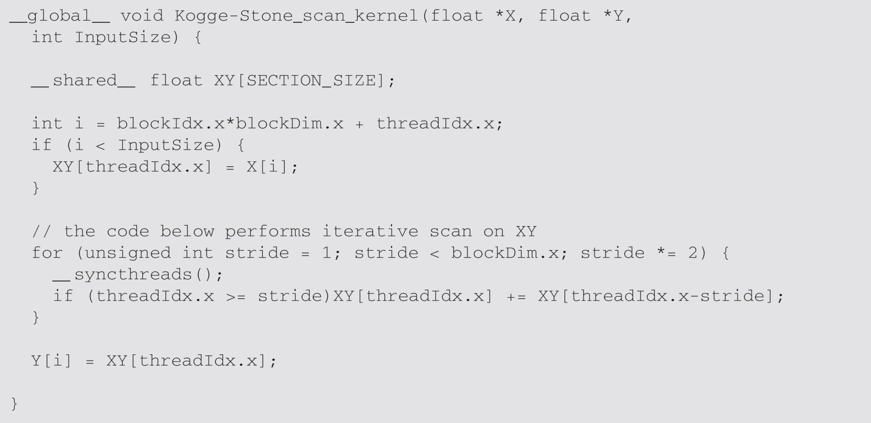
FIGURE 8.2: A Kogge–Stone kernel for inclusive scan.

Slide 4
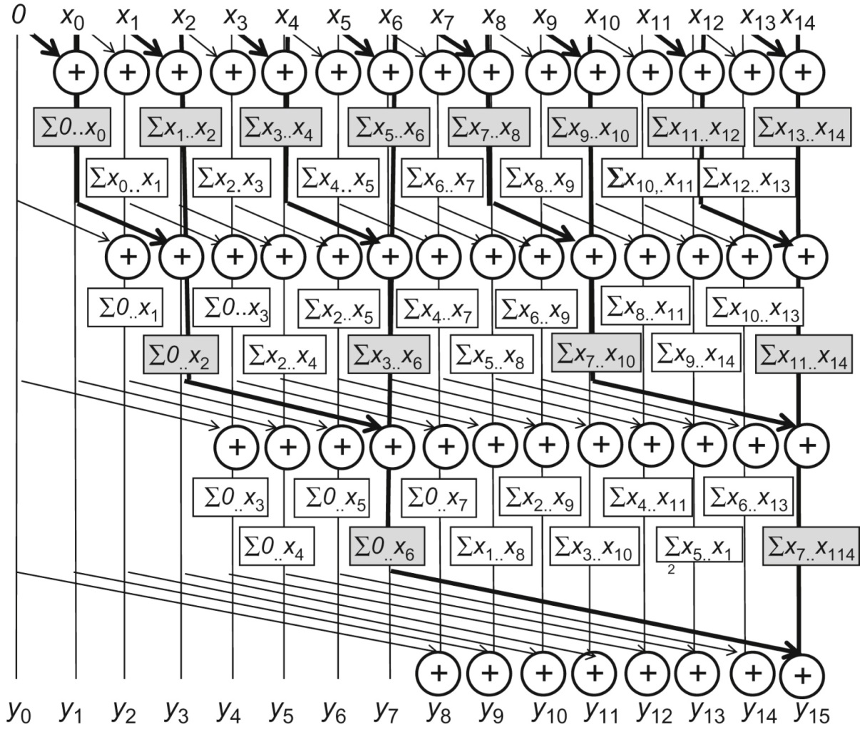
FIGURE 8.3: A parallel exclusive scan algorithm based on Kogge–Stone adder design.

Slide 5
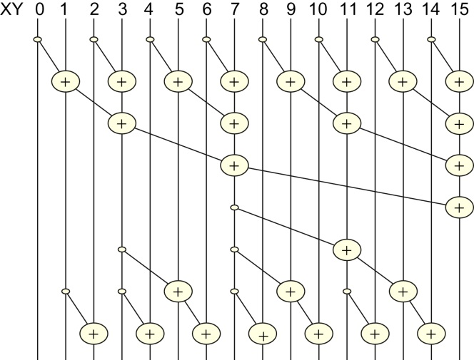
FIGURE 8.4: A parallel inclusive scan algorithm based on the Brent–Kung adder design.

Slide 6
FIGURE 8.5: Partial sums available in each XY element after the reduction tree phase.

Slide 7
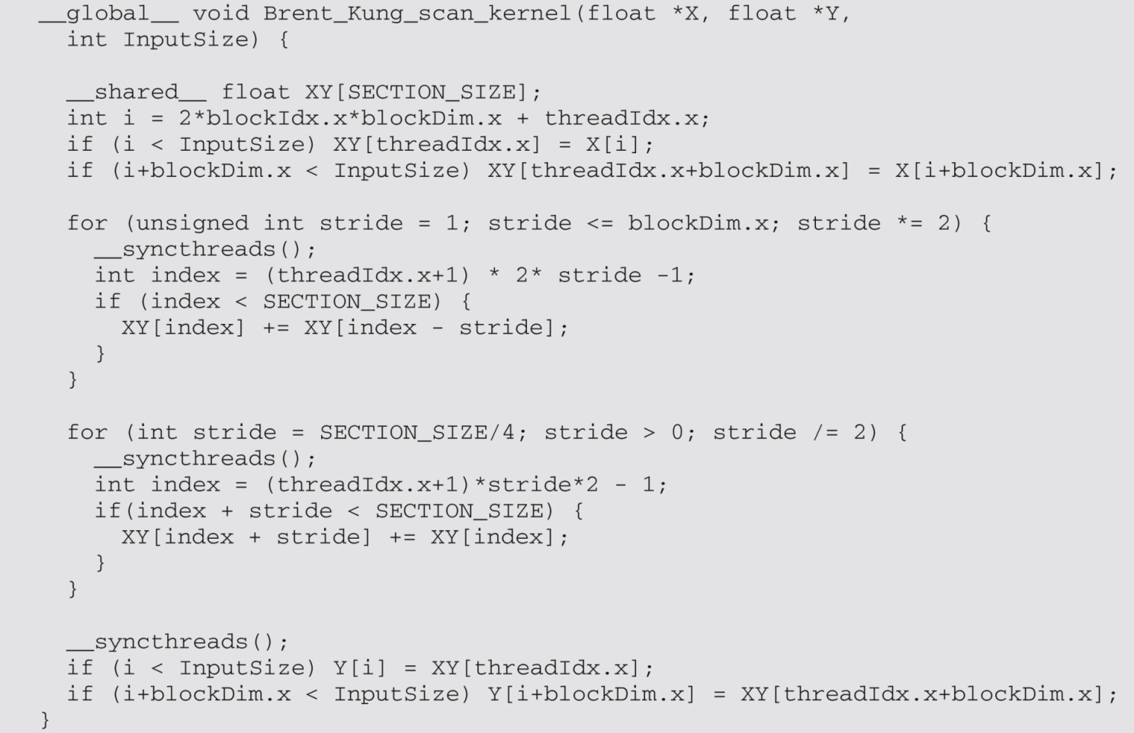
FIGURE 8.6: A Brent–Kung kernel for inclusive scan.

Slide 8
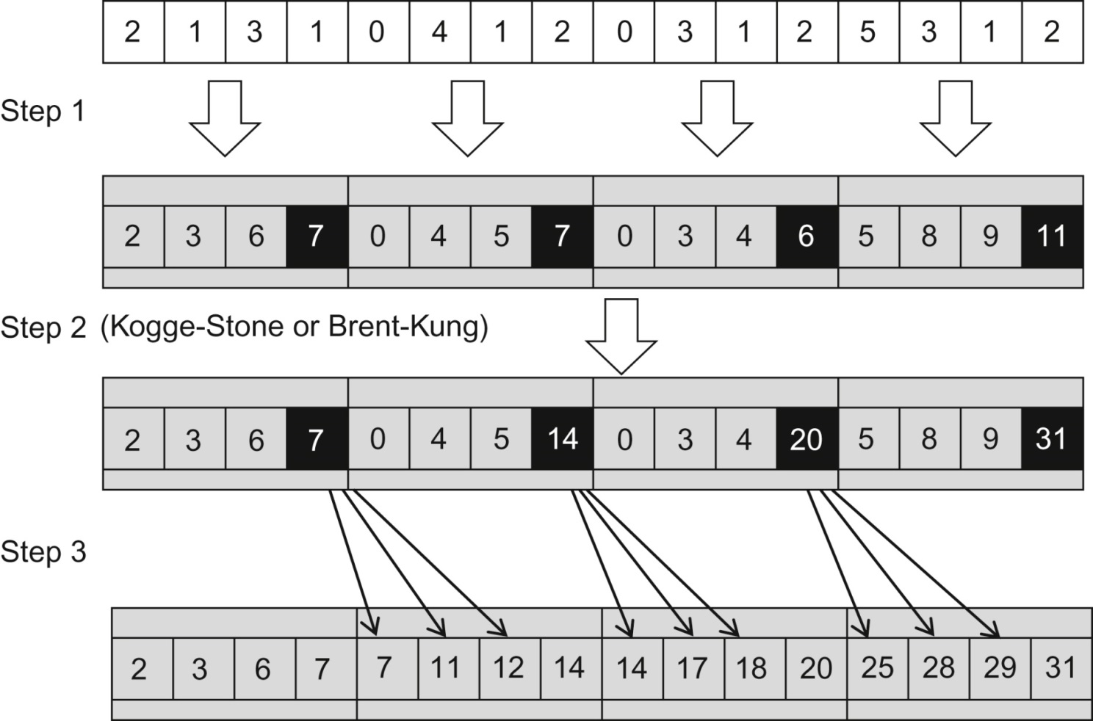
FIGURE 8.7: Three-phase parallel scan for higher work efficiency and speed.

Slide 9
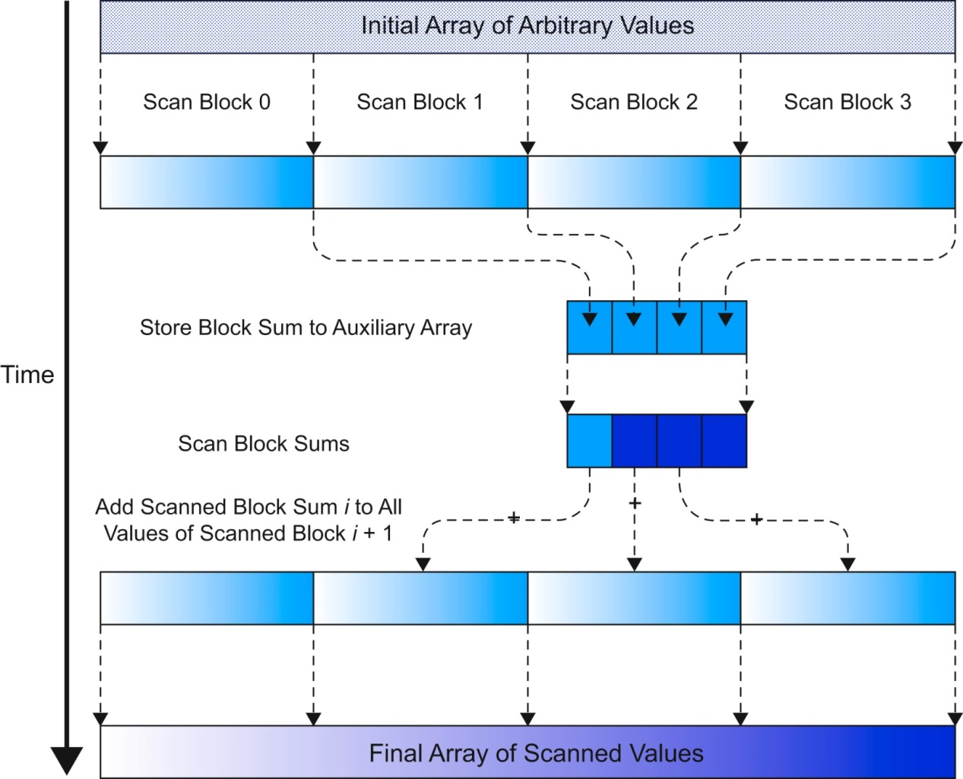
FIGURE 8.8: A hierarchical scan for arbitrary length inputs.

Slide 10
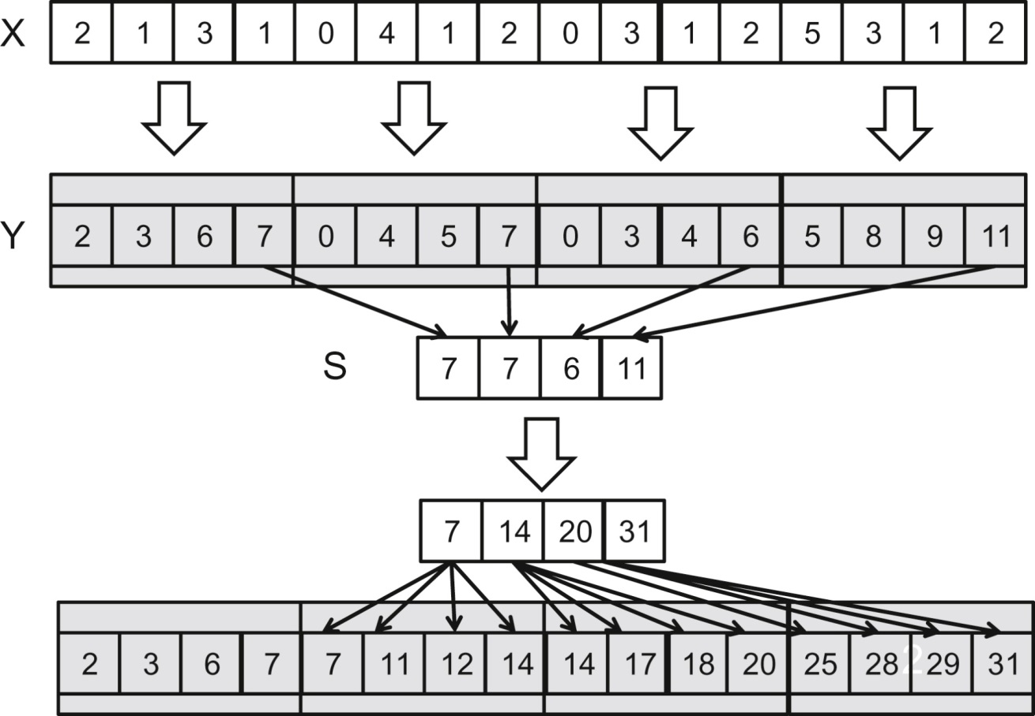
FIGURE 8.9: An example of hierarchical scan.

