Slide 1
Chapter-9 Parallel patterns—parallel histogram computation An introduction to atomic operations and privatization

Slide 2
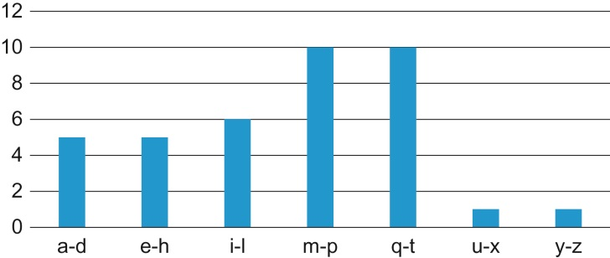
FIGURE 9.1: A histogram representation of “programming massively parallel processors.”

Slide 3
FIGURE 9.2: A simple C function for calculating histogram for an input text string.

Slide 4
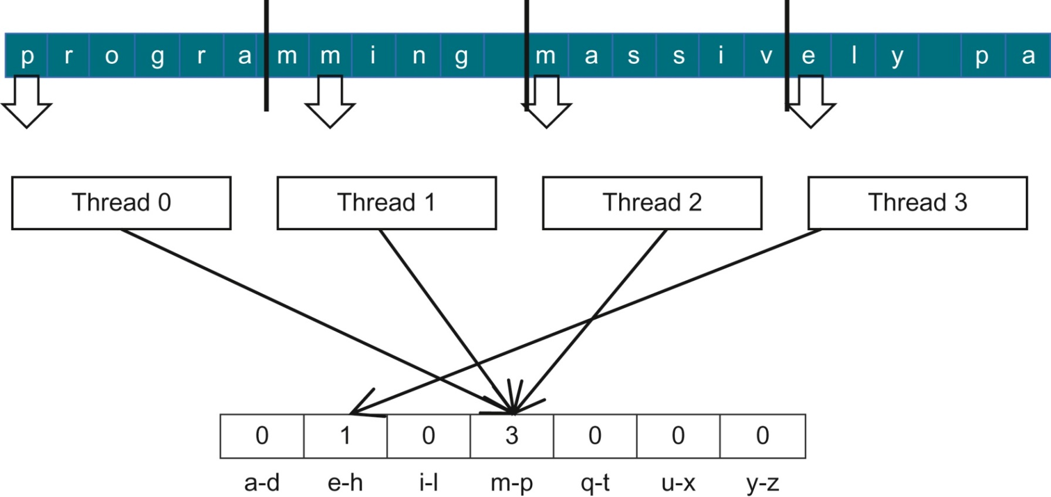
FIGURE 9.3: Strategy I for parallelizing histogram computation.

Slide 5
FIGURE 9.4: Race condition in updating a histo[] array element.

Slide 6
FIGURE 9.5: Race condition scenarios where Thread 2 runs ahead of Thread 1.

Slide 7
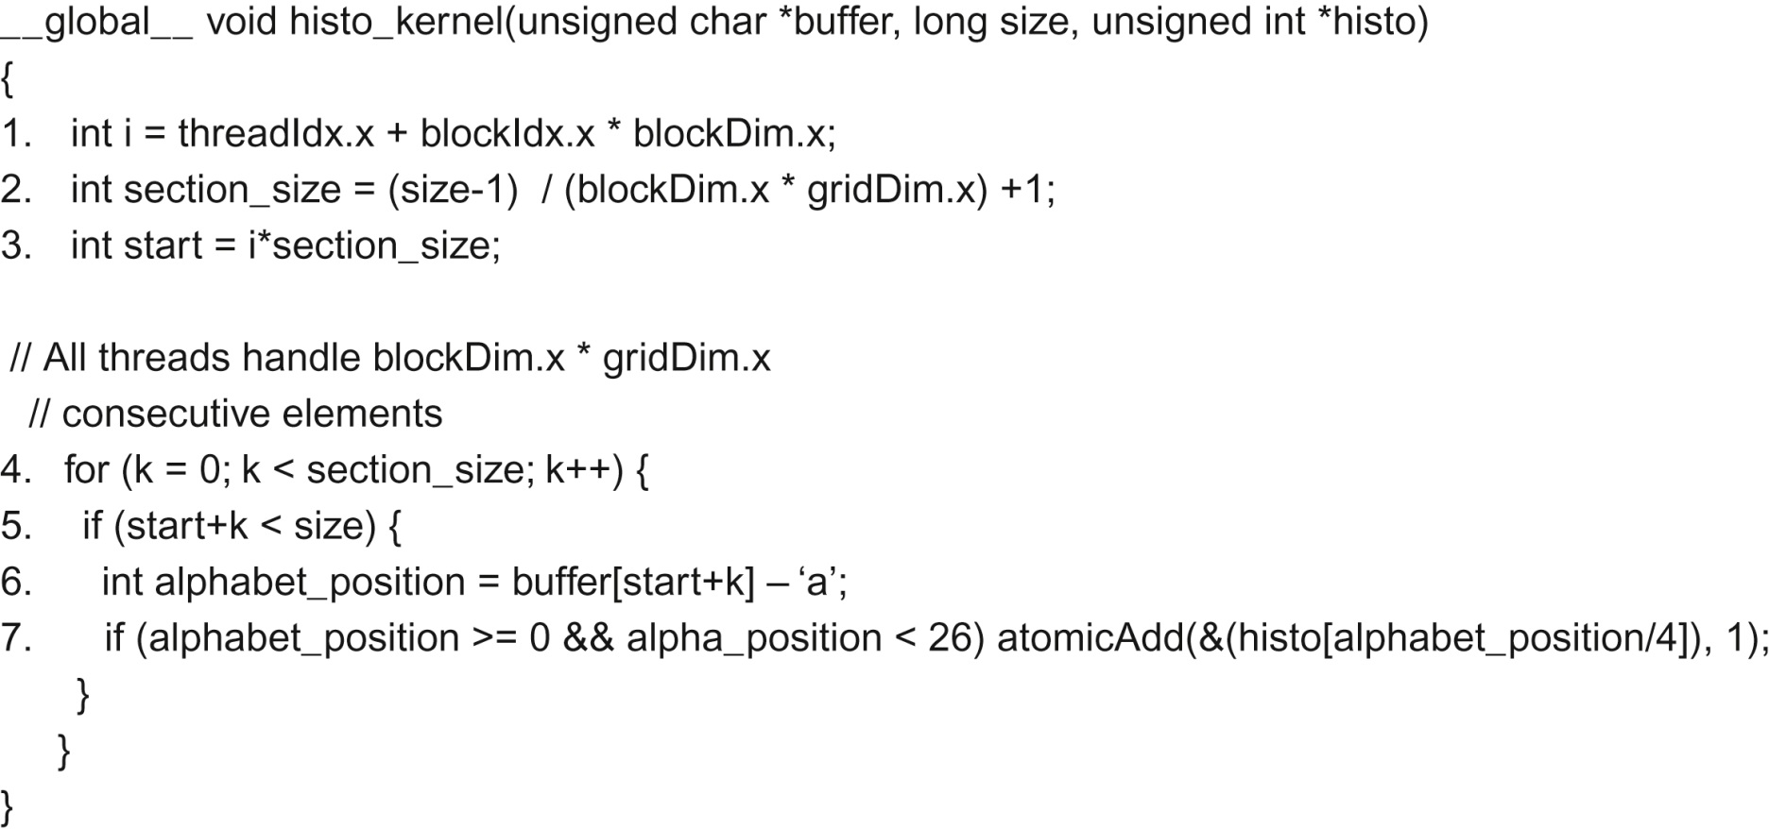
FIGURE 9.6: A CUDA kernel for calculation histogram based on Strategy I.

Slide 8
FIGURE 9.7: Desirable access pattern to the input buffer for memory coalescing—Strategy II.

Slide 9
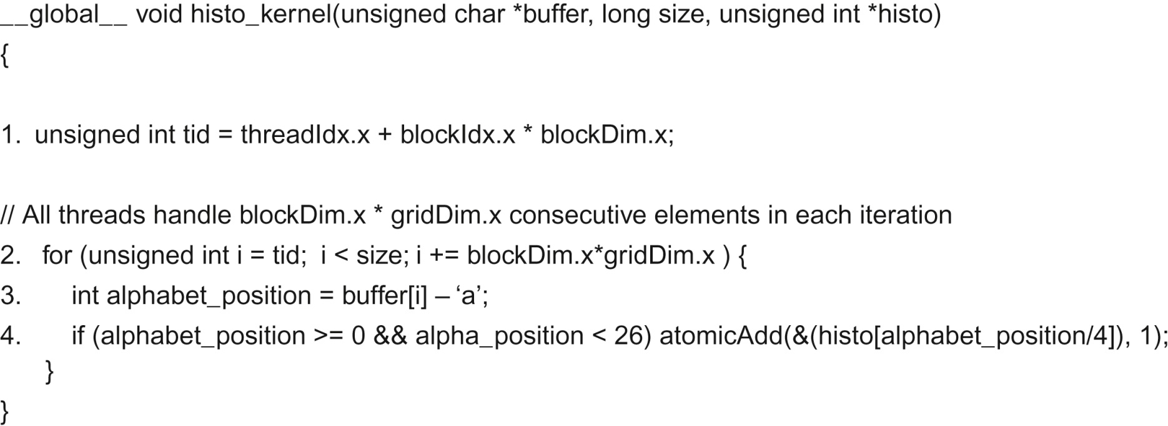
FIGURE 9.8: A CUDA kernel for calculating histogram based on Strategy II.

Slide 10
FIGURE 9.9: Throughput of atomic operation is determined by the memory access latency.

Slide 11
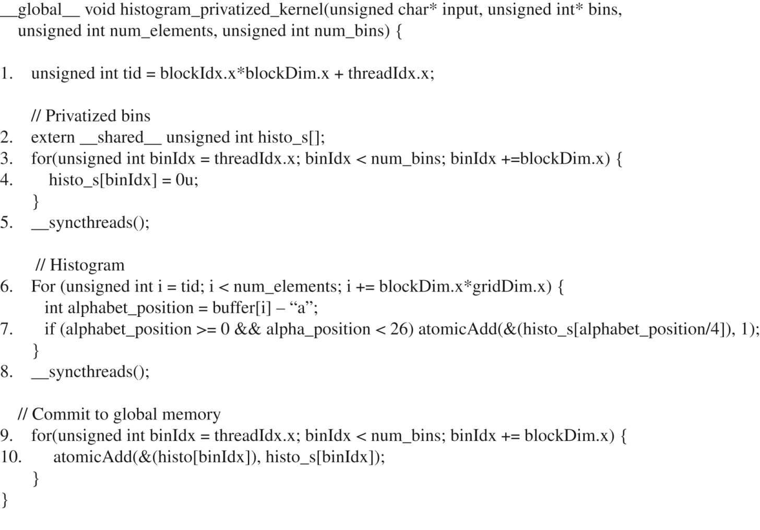
FIGURE 9.10: A privatized text histogram kernel.

Slide 12
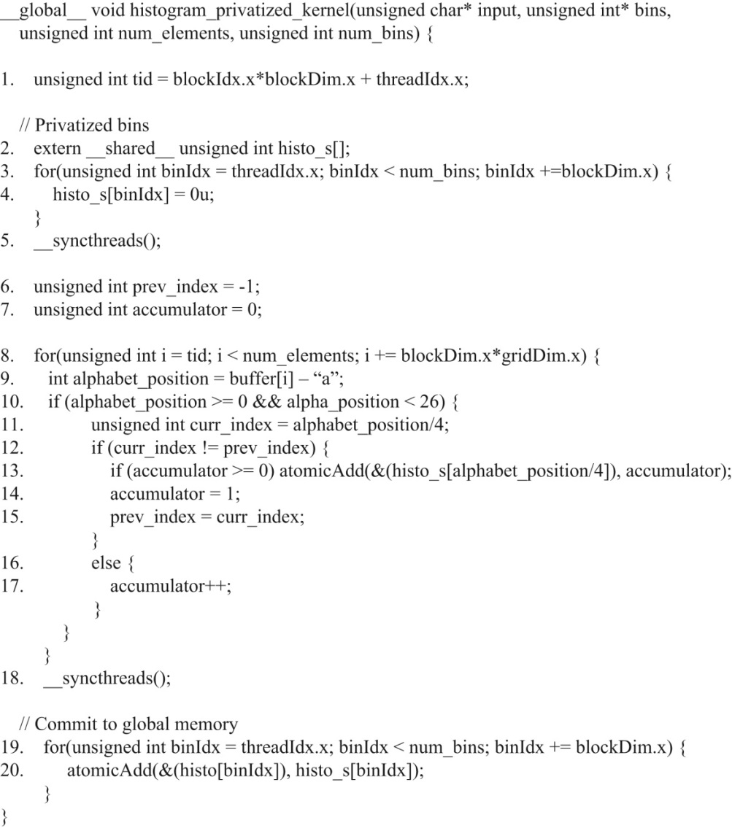
FIGURE 9.11: An aggregated text histogram kernel.

