Slide 1
Chapter-10 Parallel patterns: sparse matrix computation An introduction to data compression and regularization

Slide 2
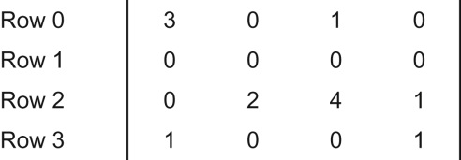
FIGURE 10.1: A simple sparse matrix example.

Slide 3
FIGURE 10.2: Example of Compressed Sparse Row (CSR) format.

Slide 4
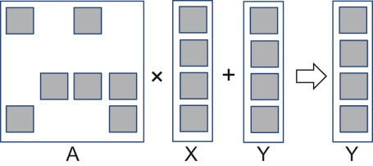
FIGURE 10.3: An example of matrix–vector multiplication and accumulation.

Slide 5
FIGURE 10.4: A sequential loop that implements SpMV based on the CSR format.

Slide 6
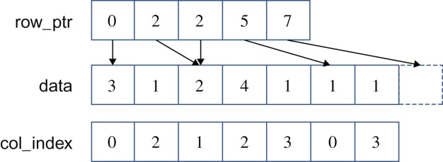
FIGURE 10.5: Illustration of the sequential SpMV loop when operating on the sparse matrix example in Fig. 10.1.

Slide 7
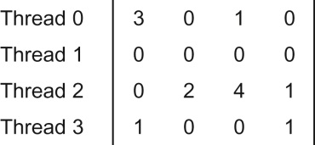
FIGURE 10.6: Example of mapping threads to rows in parallel SpMV/CSR.

Slide 8
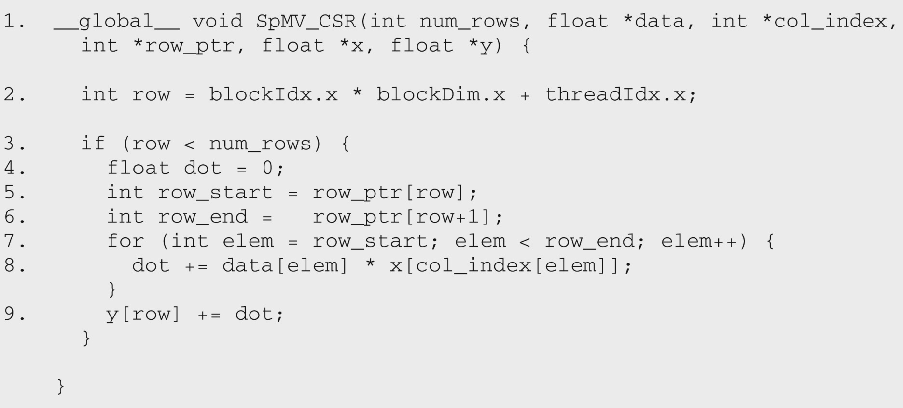
FIGURE 10.7: A parallel SpMV/CSR kernel.

Slide 9
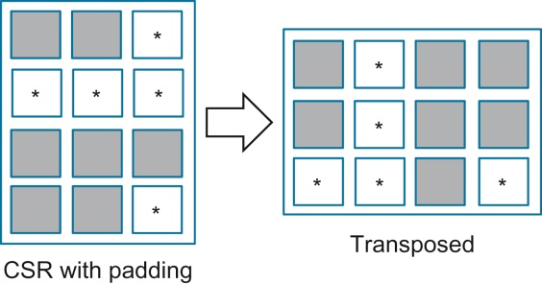
FIGURE 10.8: ELL storage format.

Slide 10
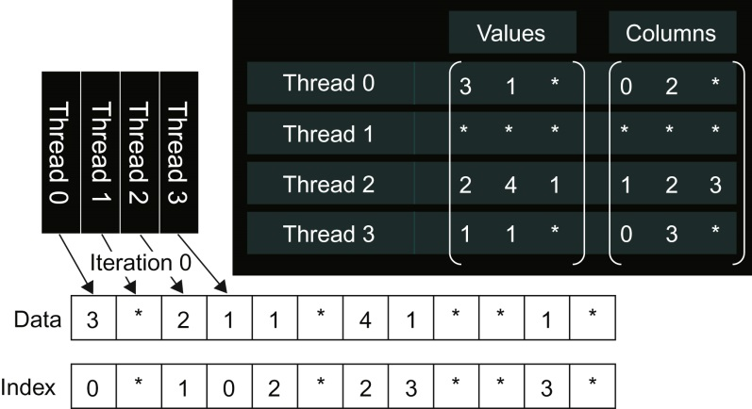
FIGURE 10.9: More details of our small example in ELL.

Slide 11
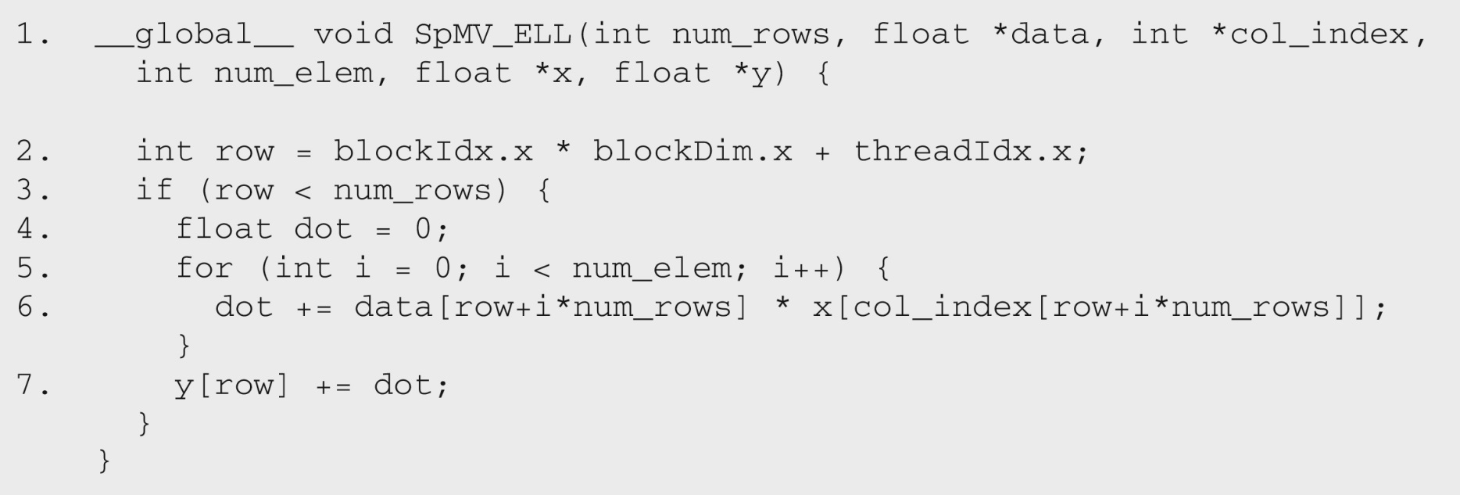
FIGURE 10.10: A parallel SpMV/ELL kernel.

Slide 12
FIGURE 10.11: Example of Coordinate (COO) format.

Slide 13
FIGURE 10.12: Reordering the Coordinate (COO) format.

Slide 14
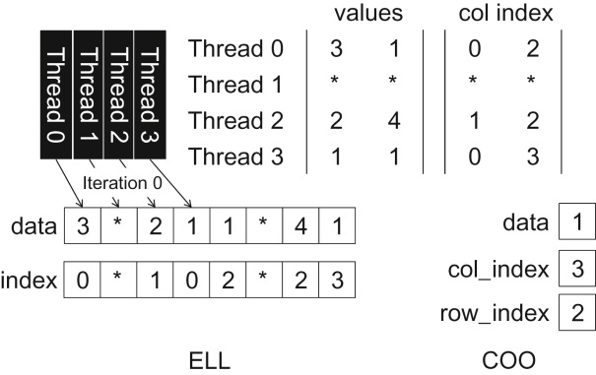
FIGURE 10.13: Our small example in ELL and COO hybrid.

Slide 15
FIGURE 10.14: A sequential loop that implements SpMV/COO.

Slide 16
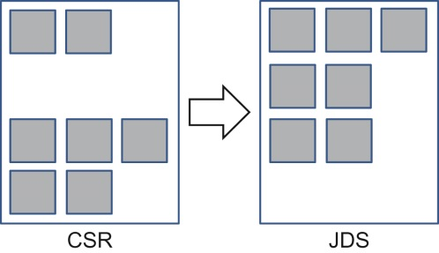
FIGURE 10.15: Sorting rows according to their length.

Slide 17
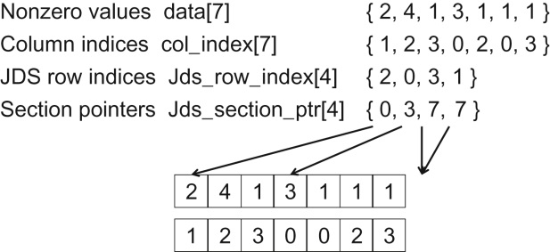
FIGURE 10.16: JDS format and sectioned ELL.

