Slide 1
Chapter-12 Parallel patterns: graph search

Slide 2
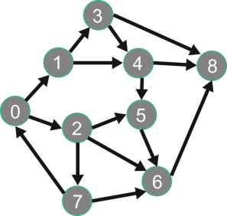
FIGURE 12.1: A simple graph with directional edges.

Slide 3
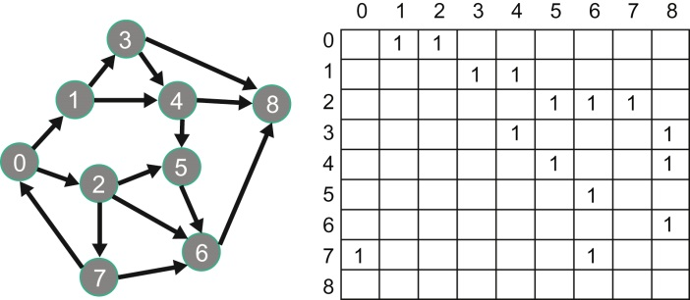
FIGURE 12.2: Adjacency matrix representation of the simple graph example.

Slide 4
FIGURE 12.3: Sparse matrix (CSR) representation of adjacency matrix.

Slide 5
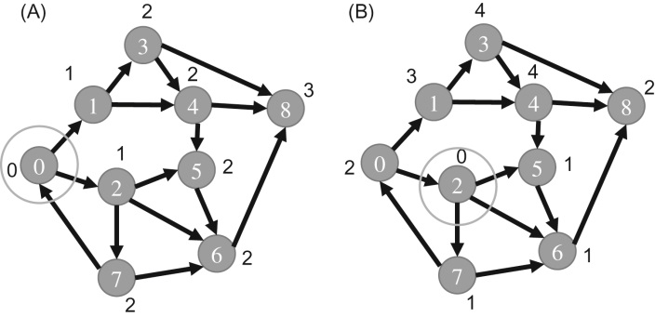
FIGURE 12.4: Breadth-first search results. (A) Vertex 0 is source, (B) vertex 2 is source.

Slide 6
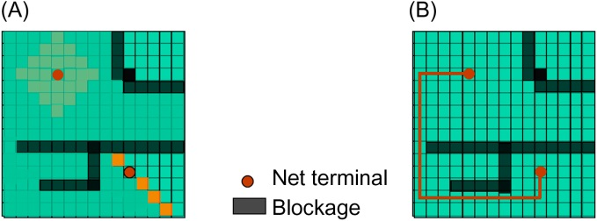
FIGURE 12.5: Maze routing in integrated circuits—an application for breadth-first search. (A) Breadth-first search, (B) identifying a routing path.

Slide 7
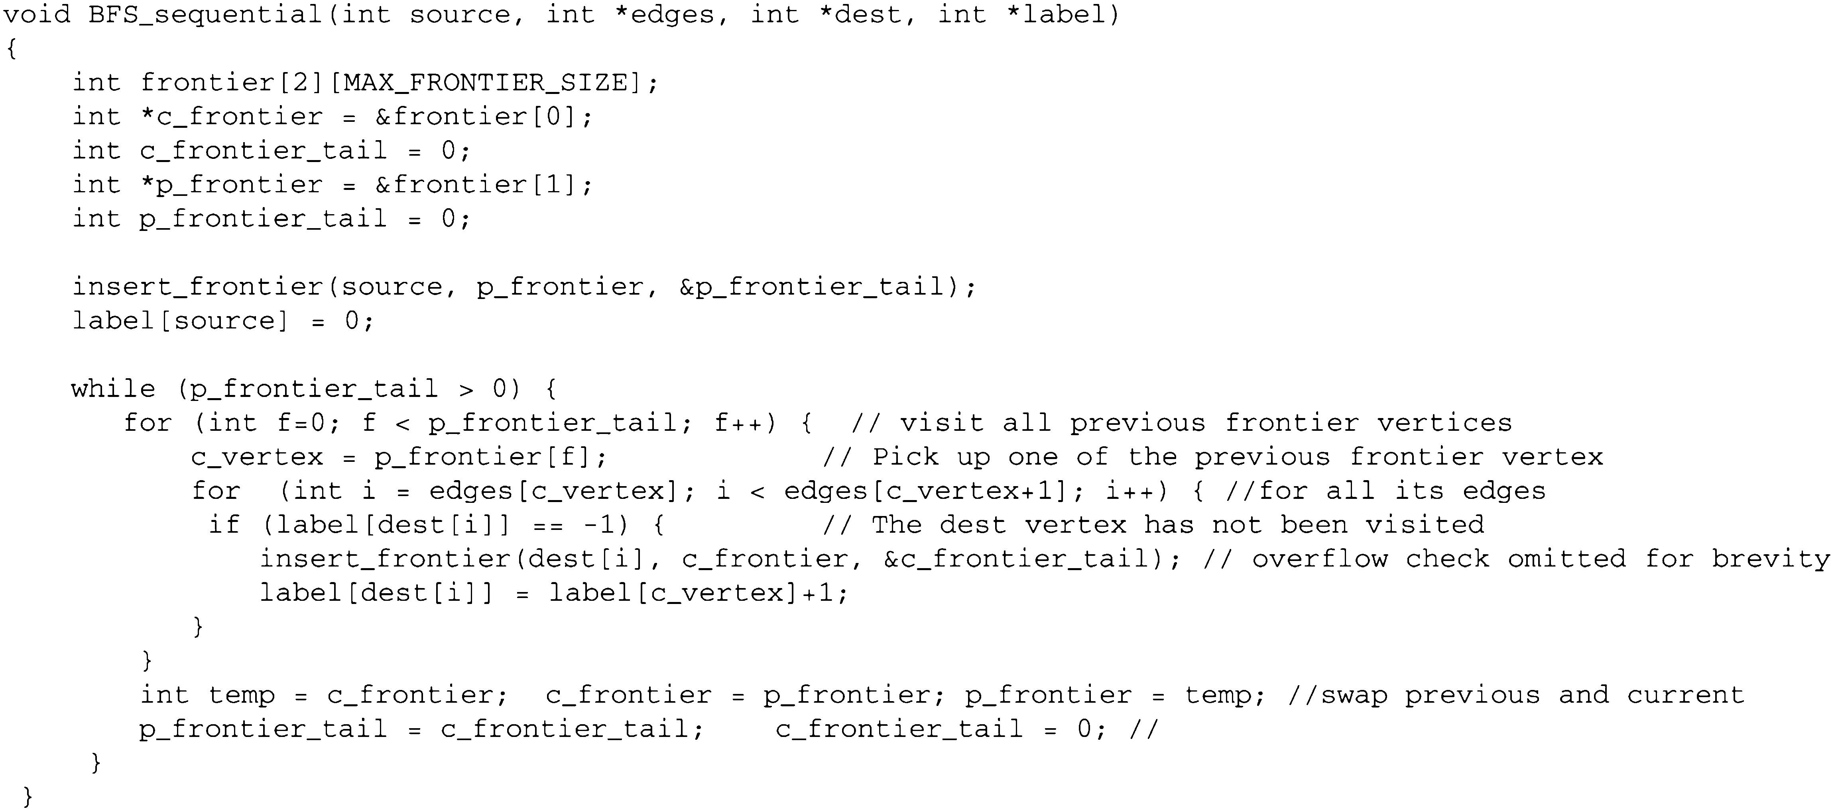
FIGURE 12.6: A sequential breadth-first search function.

Slide 8
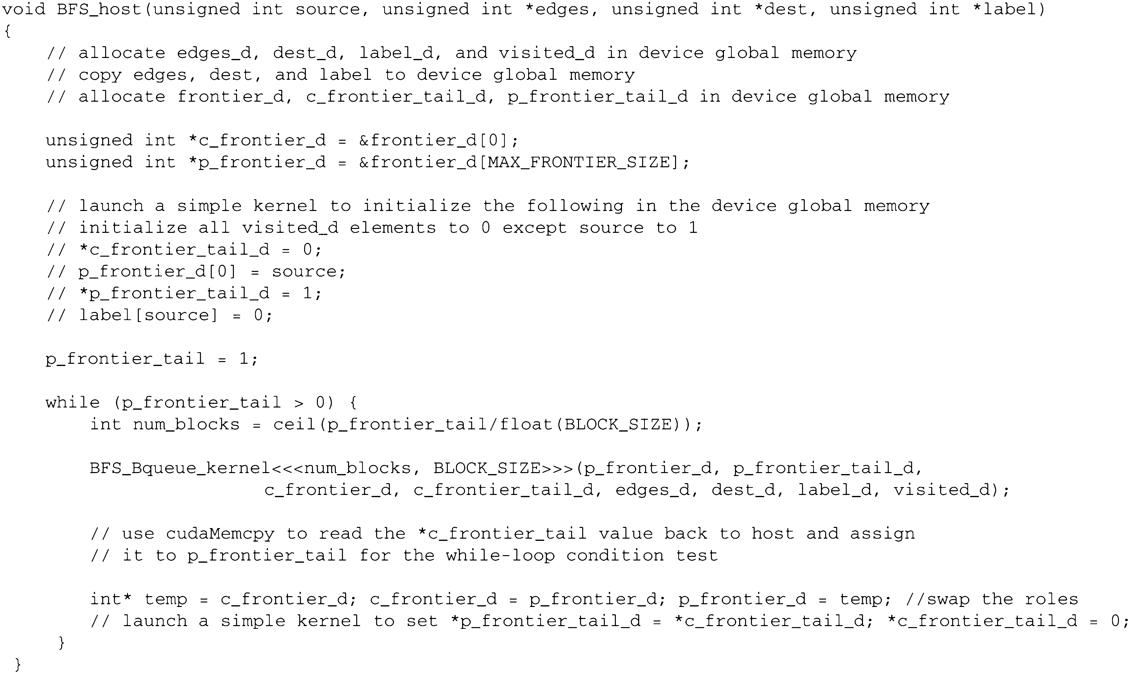
FIGURE 12.7: A sketch of the BFS host code function.

Slide 9
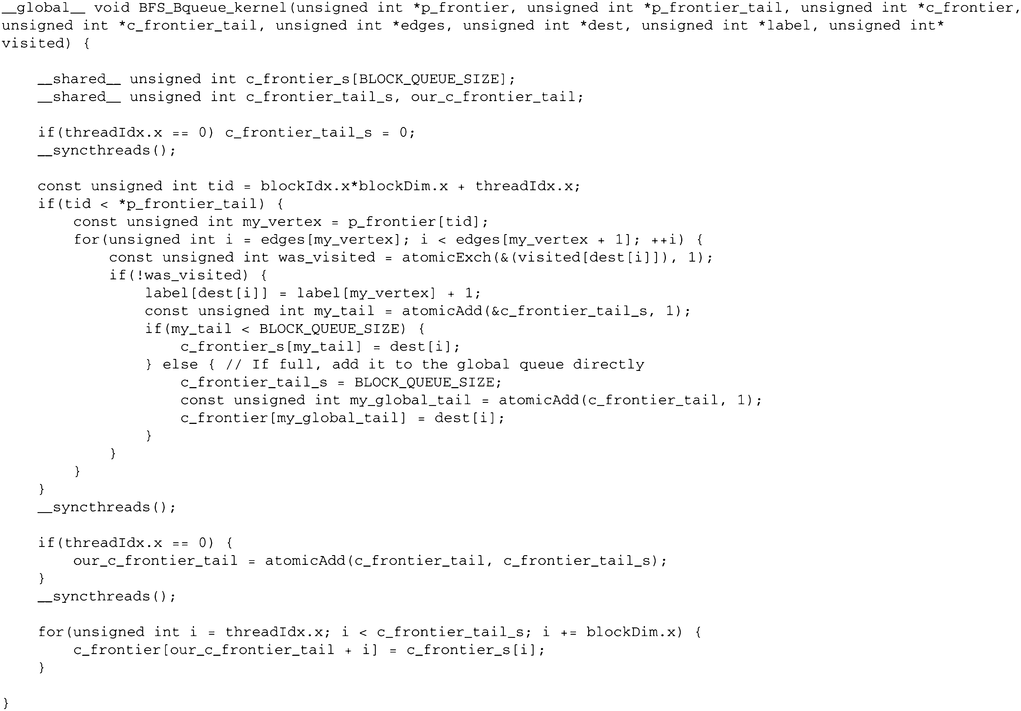
FIGURE 12.8: A parallel BFS kernel based on block-level privatized queues.

Slide 10
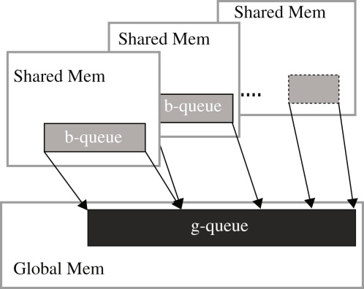
FIGURE 12.9: Block-level queue (b-queue) contents are copied into the global queue (g-queue) at the end of the kernel in a coalesced manner.

Slide 11
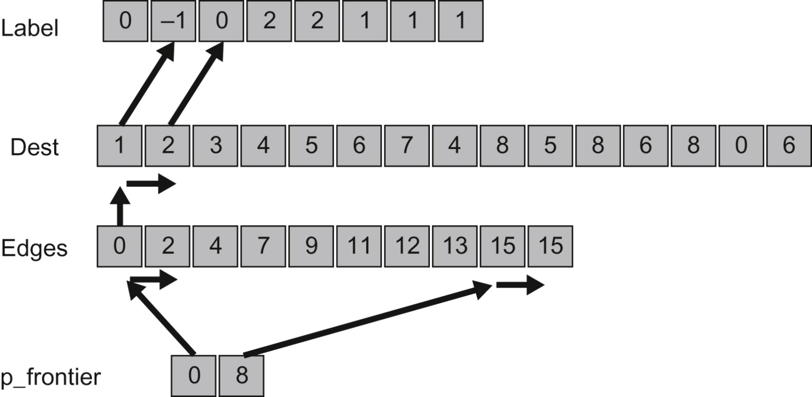
FIGURE 12.10: Memory access pattern for processing the level-2 frontier in Fig. 12.5.

Slide 12
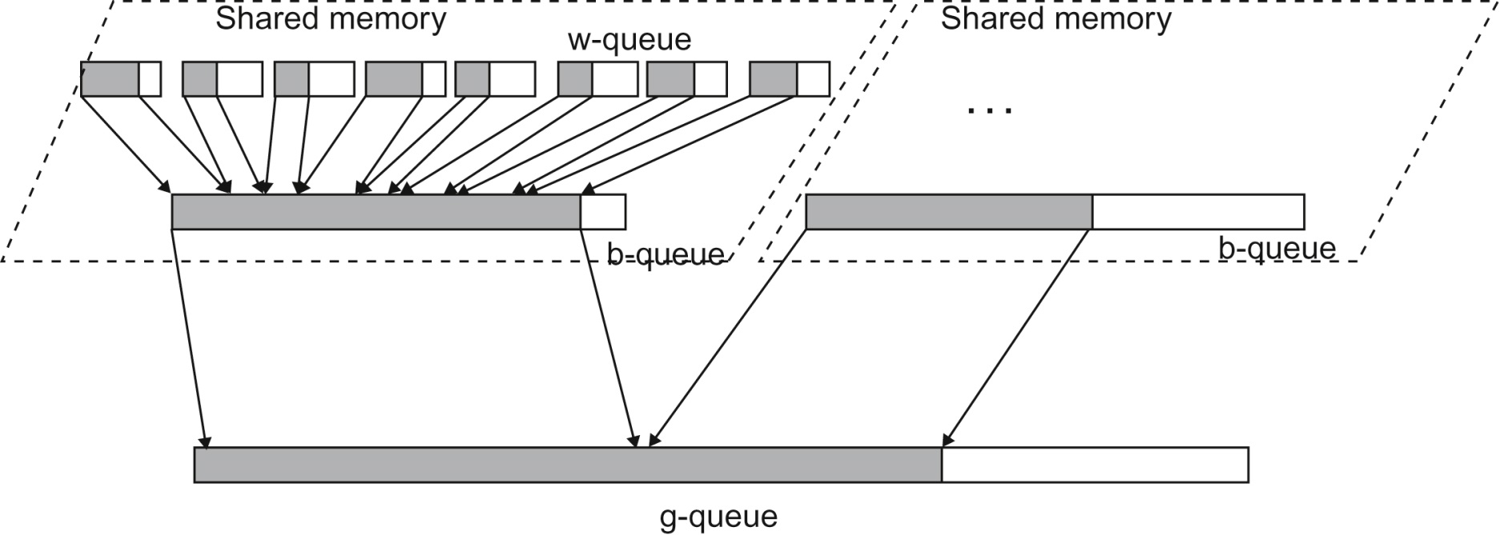
FIGURE 12.11: The design and consolidation process of w-queue, b-queue, and g-queue.

