Slide 1
Chapter-15 Application case study— molecular visualization and analysis

Slide 2
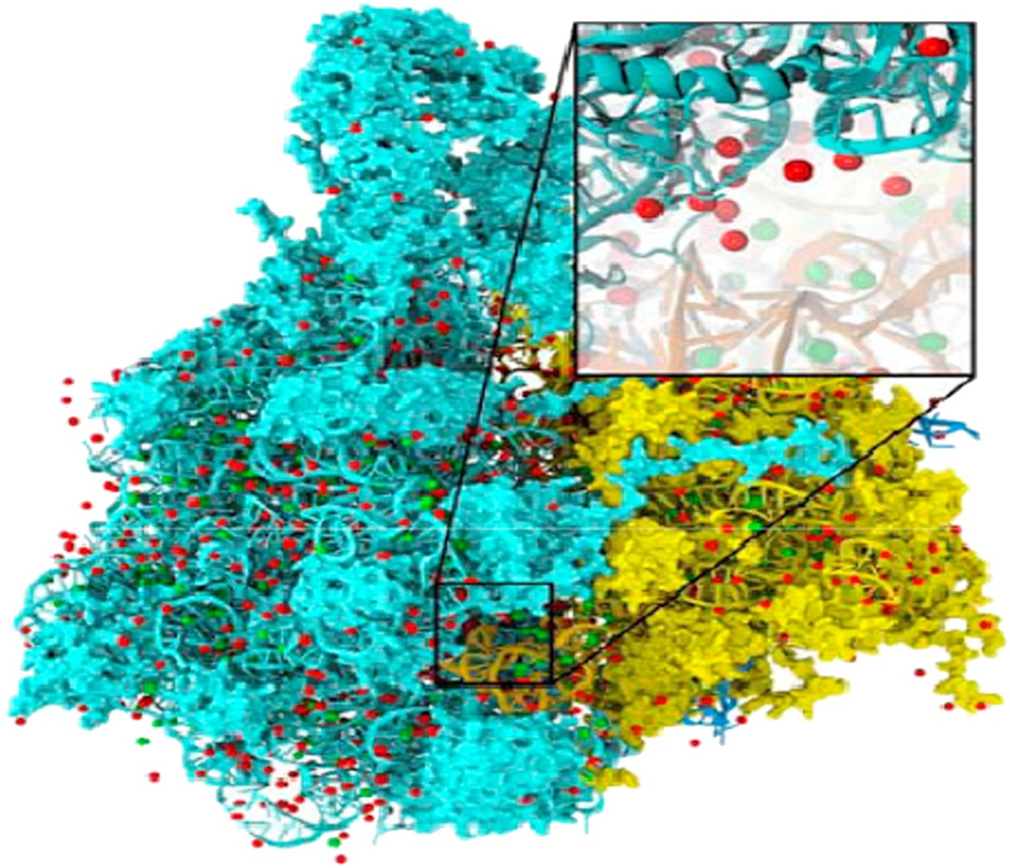
FIGURE 15.1: Electrostatic potential map is used in building stable structures for molecular dynamics simulation.

Slide 3
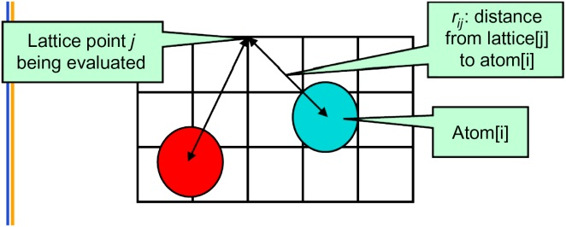
FIGURE 15.2: The contribution of atom[i] to the electrostatic potential at lattice point j (potential[j]) is atom[i] charge/r^{ij}. In the Direct Coulomb Summation method, the total potential at lattice point j is the sum of contributions from all atoms in the system.

Slide 4
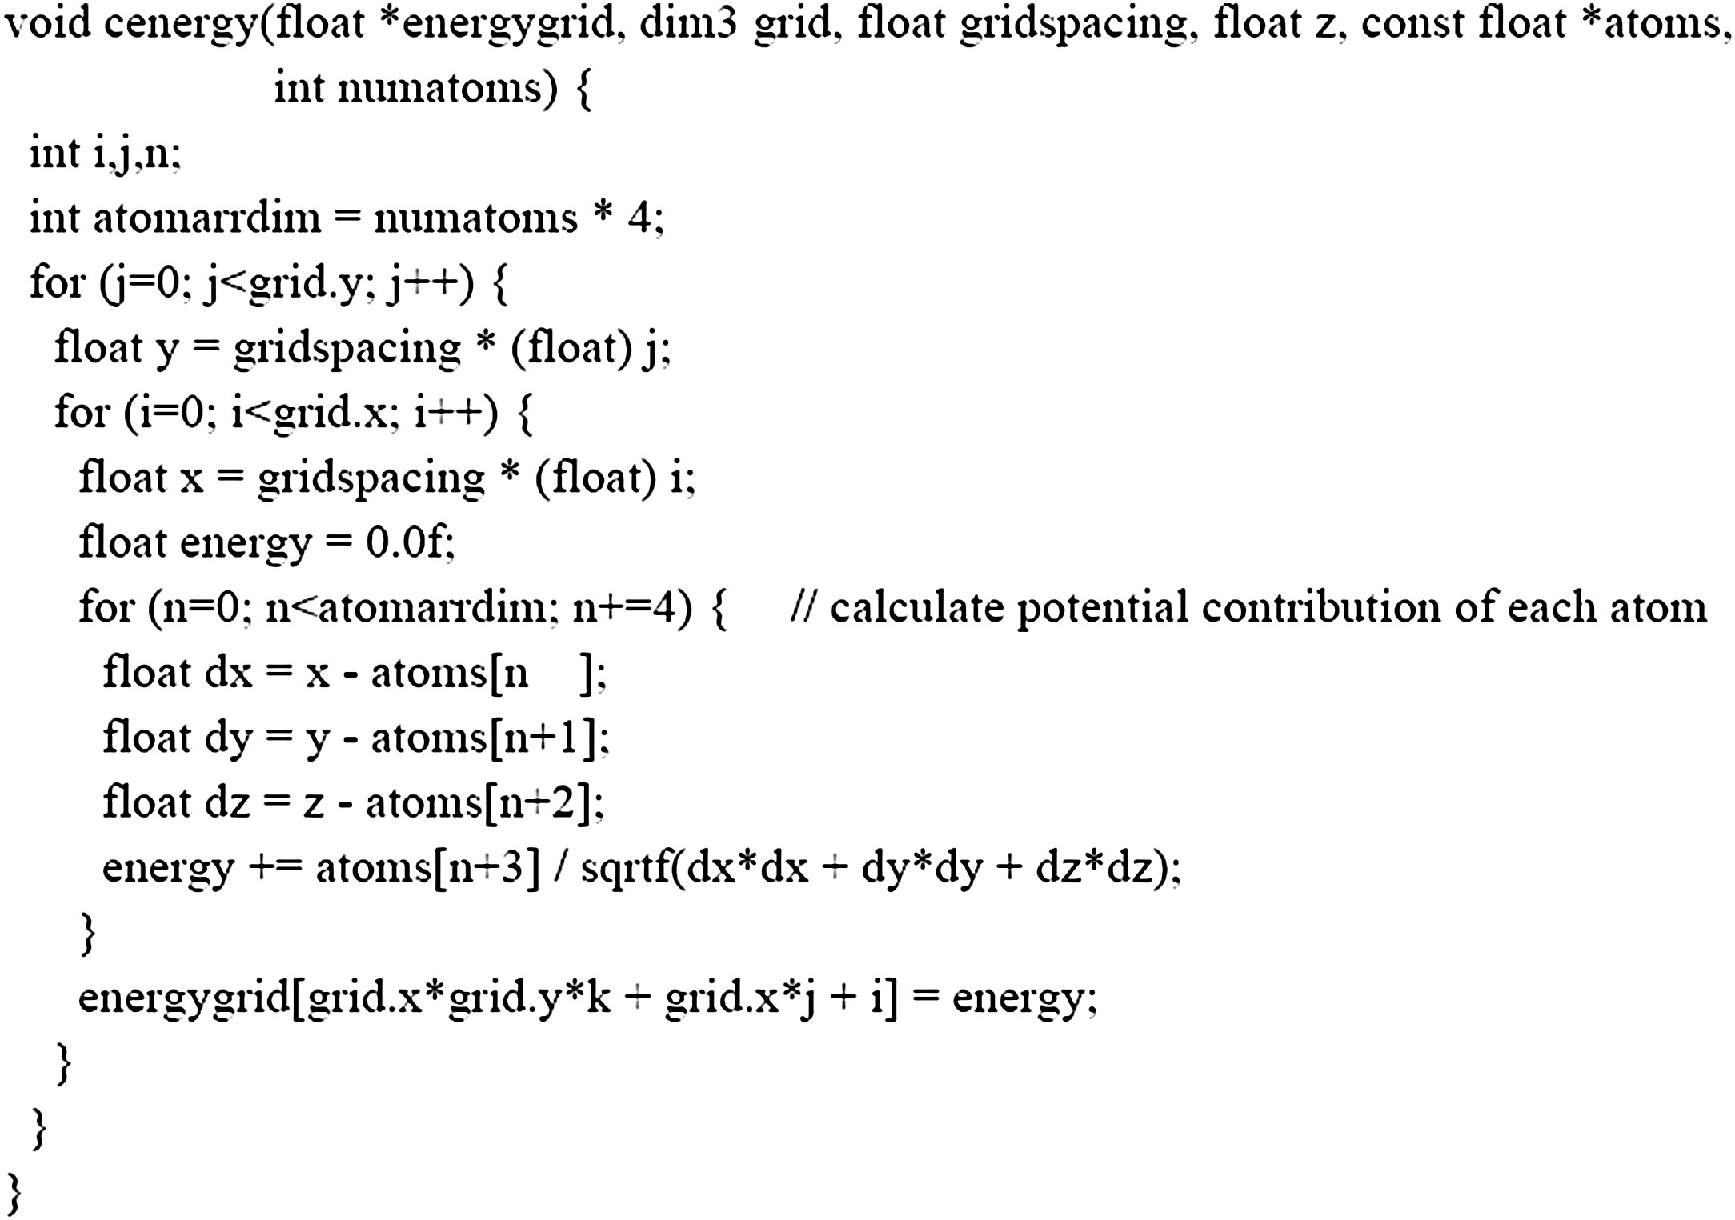
FIGURE 15.3: Base Coulomb potential calculation code for a 2D slice.

Slide 5
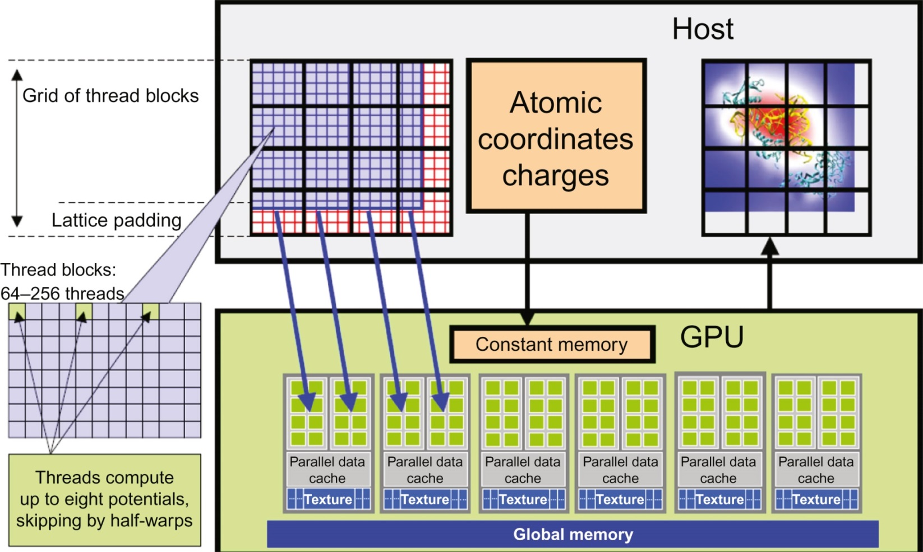
FIGURE 15.4: Overview of the DCS kernel design.

Slide 6
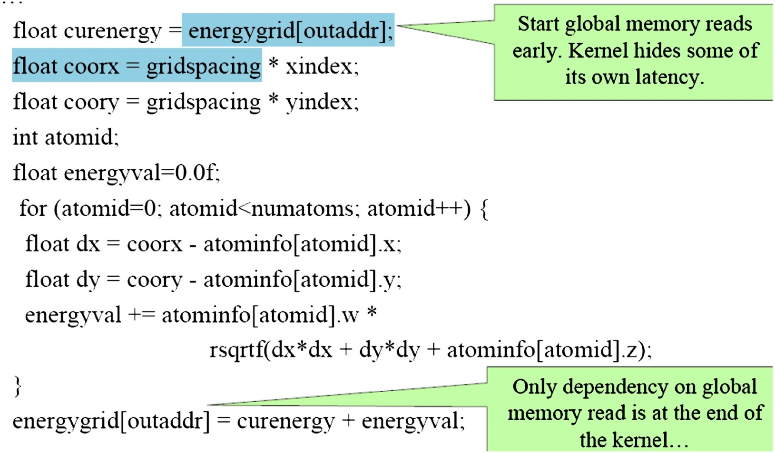
FIGURE 15.5: DCS kernel version 1.

Slide 7
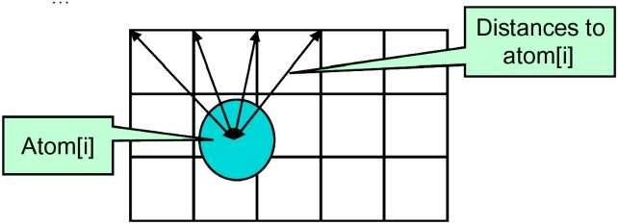
FIGURE 15.6: Reusing computation results among multiple grid points.

Slide 8
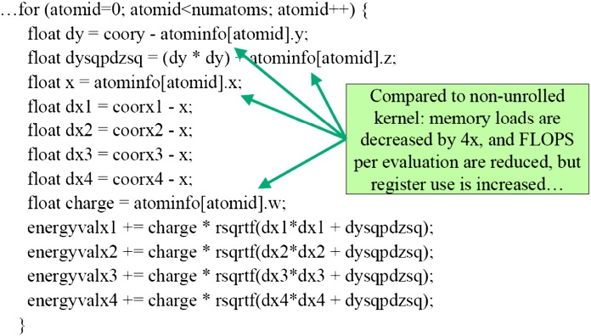
FIGURE 15.7: Version 2 of the DCS kernel.

Slide 9
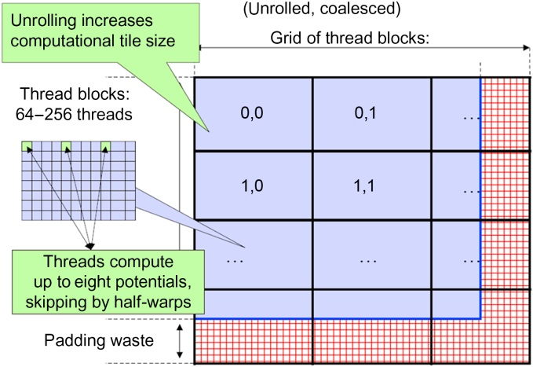
FIGURE 15.8: Organizing threads and memory layout for coalesced writes.

Slide 10
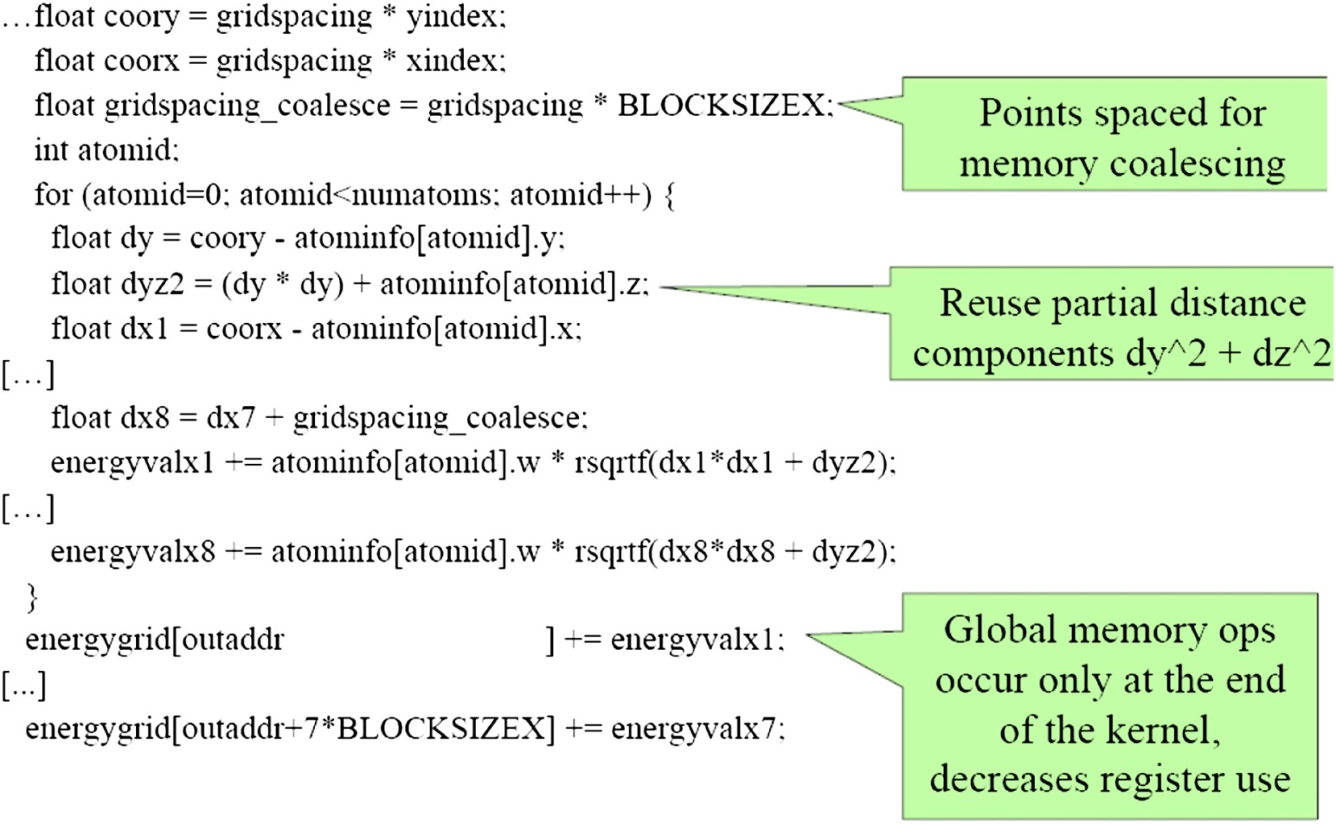
FIGURE 15.9: DCS kernel version 3.

Slide 11
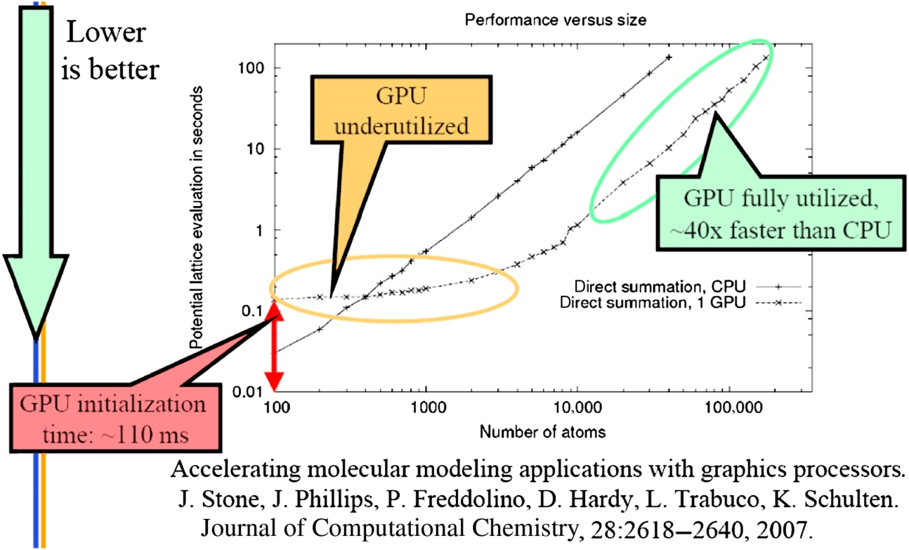
FIGURE 15.10: Single-threads CPU versus CPU–GPU comparison.

