Slide 1
Chapter-17 Parallel programming and computational thinking

Slide 2
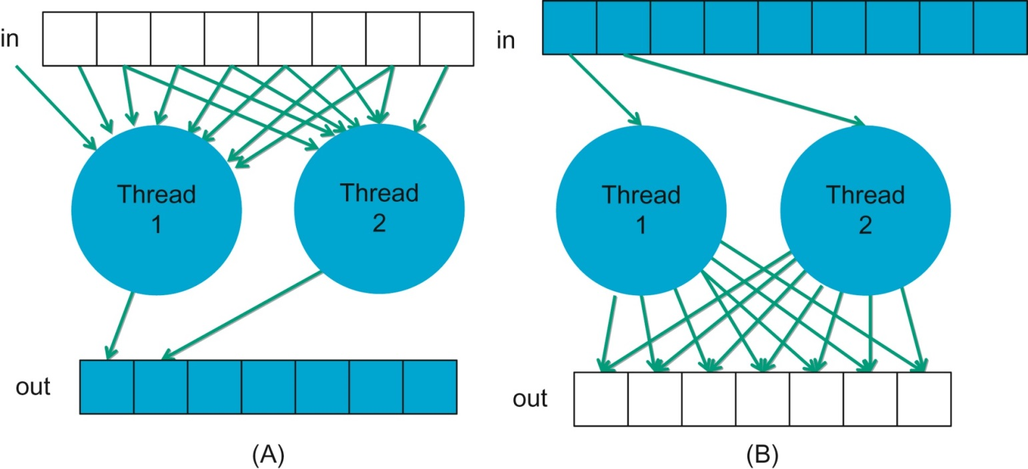
FIGURE 17.1: (A) Gather and (B) scatter based thread arrangements.

Slide 3
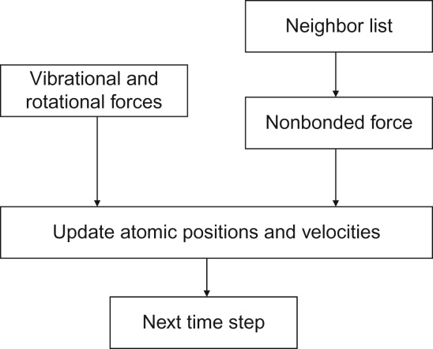
FIGURE 17.2: Major tasks of a molecular dynamics application.

Slide 4
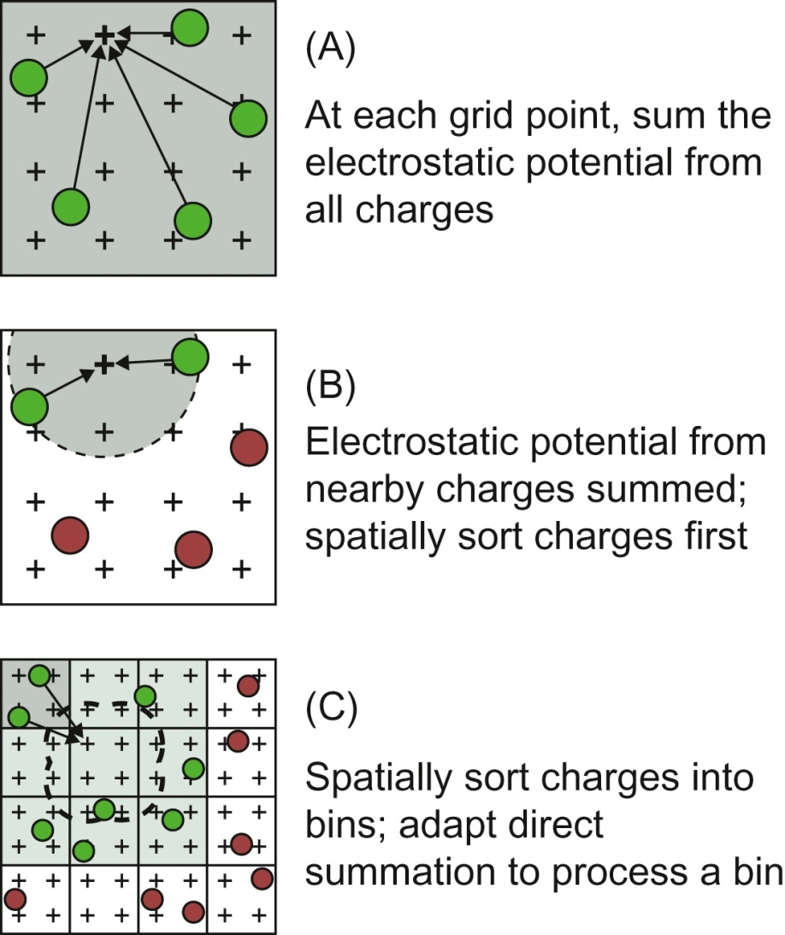
FIGURE 17.3: Cutoff summation algorithm. (A) Direct summation, (B) cutoff summation, and (C) cutoff summation using direct summation kernel.

Slide 5
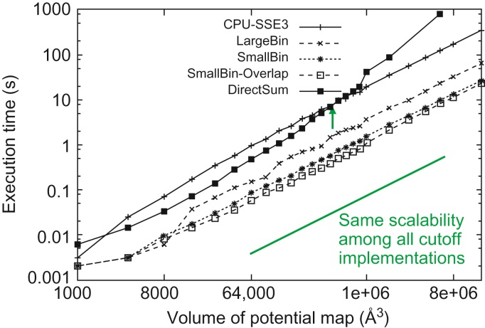
FIGURE 17.4: Scalability and performance of different algorithms for calculating electrostatic potential map.

Slide 6
FIGURE 17.5: Sodium images of the brain. Courtesy of Keith Thulborn and Ian Atkinson, Center for MR Research, University of Illinois at Chicago.

Slide 7
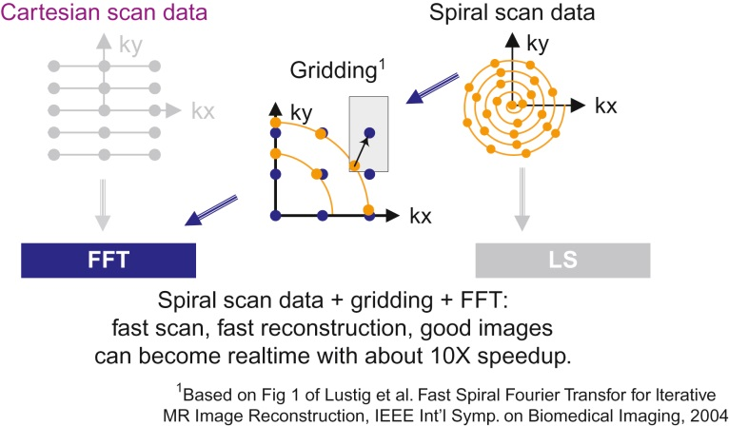
FIGURE 17.6: Classical gridded MRI reconstruction from spiral scan data.

Slide 8
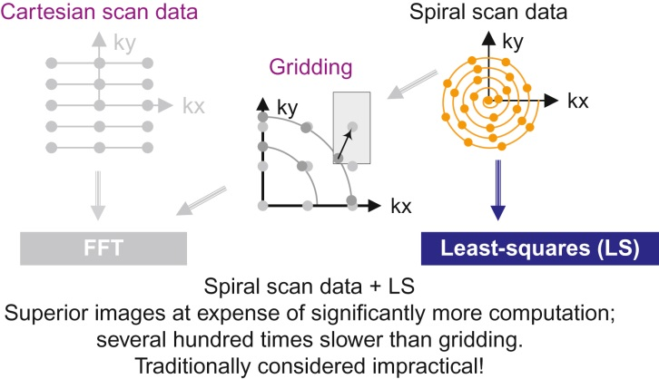
FIGURE 17.7: Least squares reconstruction of spiral scan data.

