Slide 1
Chapter-20 More on CUDA and graphics processing unit computing

Slide 2
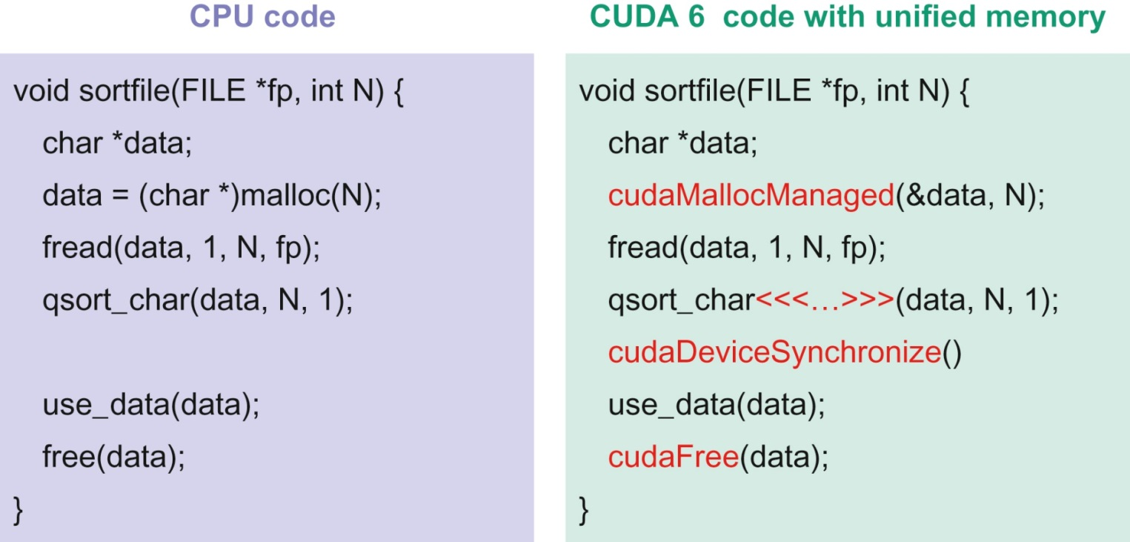
FIGURE 20.1: Unified Memory simplifies porting of CPU code (left) to CUDA code (right).

Slide 3
FIGURE 20.2: Importance of critical-path analysis for identifying the key kernels to optimize.

Slide 4
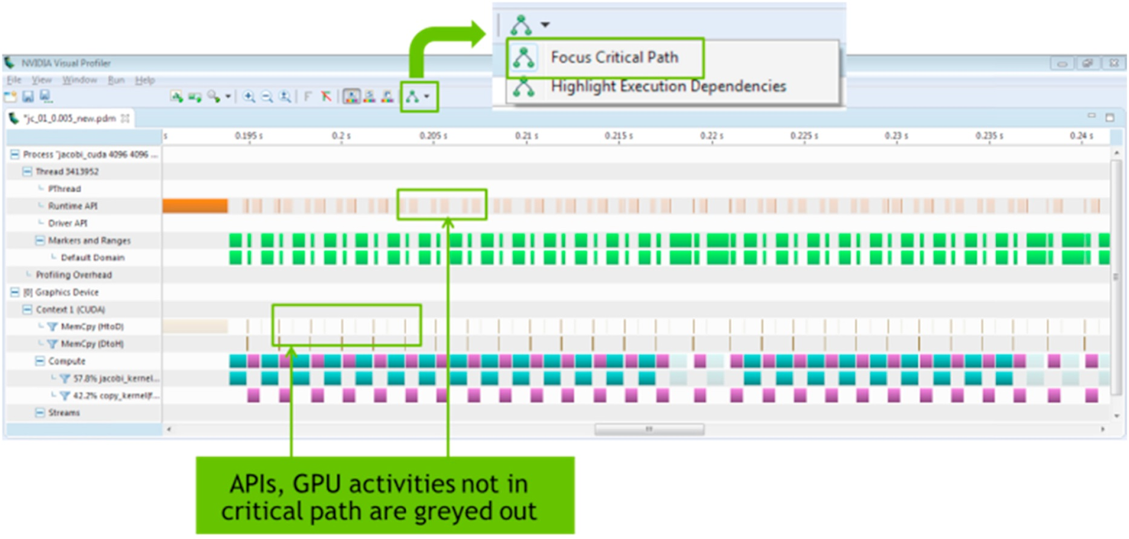
FIGURE 20.3: Application critical-path analysis in CUDA 8 Visual Profiler.

